Slide 1



Presentation XIII
Bone Tissue Phantom
Thu Ta Zaw
2415121095

Slide 2

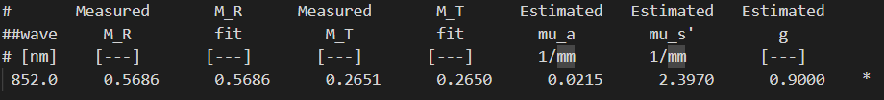
Preliminary Measurement of PLA optical properties
Table. Preliminary Measurement Result of PLA
The reduced scattering coefficient is within the range of the standard PLA.
The absorption coefficient is overestimated when compared to the standard PLA.
However, both value are acceptable upon comparing with the human bone.

Slide 3
Specimens size for Integrating Sphere Measurement
Optical Properties on Bone Analysis: An Approach to Biomaterials
Perform the measurement of the optical properties of chicken femoral samples.
Used the sample thickness of 3 mm.
Optical Properties on Bone Analysis: An Approach to Biomaterials
The total transmittance and reflectance measurements were performed I the 800-2000 nm wavelength range using the commercially available spectrometer with integrating sphere.
The thickness of the samples varied from 2.0±0.1 to 5.0±0.5 mm.

Slide 4
Specimens size for Integrating Sphere Measurement
Effect of light losses sample between two integrating spheres on optical properties estimation
When the size of the integrating sphere port is constant, the dependence of the error on the thickness of the sample is discussed.
The thicker the sample, the larger the error of the optical property estimation is.
The difference of error caused by the change in thickness of the sample is very tiny
Sample Thickness | Max Light Loss (A_{iad}/A₀) | Max Absorption Error (µ_{a})
0.7 mm | 125 % | 17%
0.8 mm | ~126-127 % | 18%
0.9 mm | 128 % | 19%
Table. Summary of thickness related error.

Slide 5
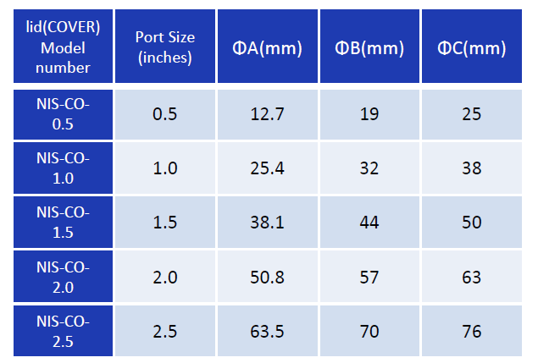

Specimens size for Integrating Sphere Measurement
Ex Vivo Optical Properties Estimation for Reliable Tissue Characterization
The size of the sample should be slightly larger than the size of the port diameter ensuring the sample completely covers the port to prevent light leakage.
Freshly excised biological samples representing soft and thin tissues (skin, skull, liver and muscle) were used with size of (2x2 ${cm}^{2}$).
For the thickness, samples should keep thin, typically under 3 mm, to avoid significant beam displacement during transmittance measurements.
The thickness of each samples is 3 mm.
Table. Ports size of the ND-Seiko Integrating sphere

Slide 6
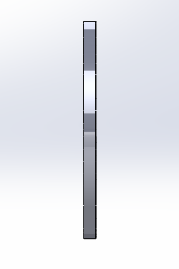


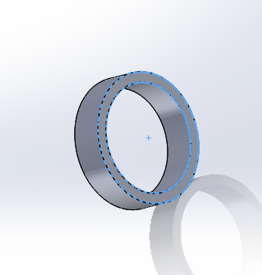
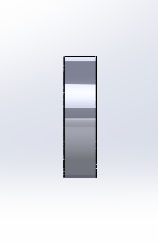
The recommend size for the specimen is (32Dx2) mm or (32x32x2) mm
Specimens size for Integrating Sphere Measurement
Fig. 32x2 mm sample side view and front view
Fig. 2 mm sample holder

Slide 7
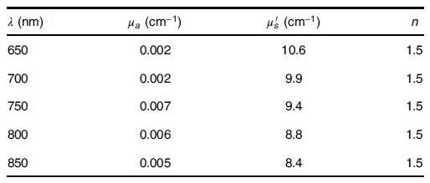
Validation For Integrating Sphere
Phantom for standardization in functional near-infrared spectroscopy, optical properties and Monte Carlo simulations
The international standard IEC 80601-2-71 defines requirements for the basic safety and essential performance of medical continuous wave functional near-infrared spectroscopy (fNIRS) equipment.
The POM-C matrix exhibits negligible absorption and monotonically decreasing reduced scattering coefficient from (10.5 down to 8.5 cm⁻¹) in the 650 to 850 nm range.
Manufacturer is Duracon NE25X, Polyplastics, Tokyo, Japan).
Table. Optical properties of the POM-C

Slide 8
Validation For Integrating Sphere
[3] Optical characterization of 3D printed PLA and ABS filaments for diffuse optics applications [extinction coefficient]
White ABS at this wavelength is more opaque than PLA due to its higher pigment loading and base polymer density.
Since the absorption coefficient (µ_{a}) at his coefficient is nearly zero, the measurement will primarily validate the scattering coefficient (µ_{s}).
Material | µ at 850 nm (cm⁻¹) | Expected Transmittance (T)
White PLA | ~62.5 | 4.4%
White ABS | ~92.0 | 1.0%
Table. Expected Transmittance for white ABS and PLA

Slide 9
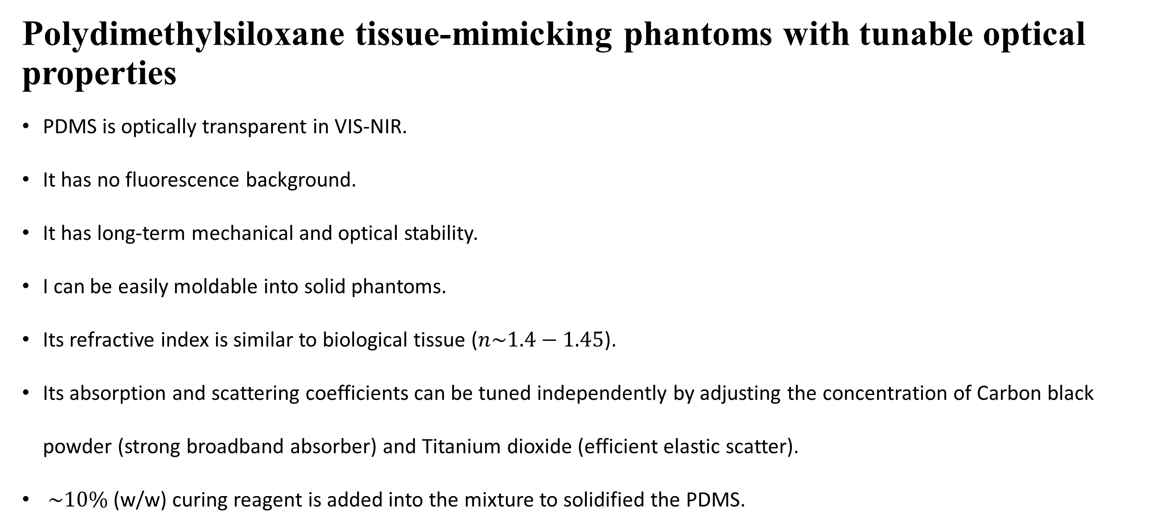
Validation For Integrating Sphere
Polydimethylsiloxane tissue-mimicking phantoms with tunable optical properties
PDMS is optically transparent in VIS-NIR.
It has no fluorescence background.
It has long-term mechanical and optical stability.
I can be easily moldable into solid phantoms.
Its refractive index is similar to biological tissue ($n\sim 1.4−1.45$).
Its absorption and scattering coefficients can be tuned independently by adjusting the concentration of Carbon black powder (strong broadband absorber) and Titanium dioxide (efficient elastic scatter).
$\sim 10\%$(w/w) curing reagent is added into the mixture to solidified the PDMS.
A step-by-step phantom fabrication procedure

Slide 10
3D printed ABS Optical Bone Phantom
Three-dimensional printed optical phantoms with customized absorption and scattering properties
Commercially available thermoplastics provide only a small range of physiologically relevant absorption coefficient (µ_{a})and reduced scattering coefficient (µ_{s}’) values.
The object of this research is to fabricate and validate customizable acrylonitrile butadiene styrene (ABS) filaments for dual extrusion 3D printing of tissue mimicking optical phantoms.
µ_{a} and µ_{s}’ values were adjustable by incorporating nigrosine and titanium dioxide in the filament extrusion process.
A wide range of physiologically relevant properties was demonstrated with average repeatability with 11.5% for µ_{a} and 7.71% for µ_{s}’ .
Advantages
3D printing with user defined optical properties may provide a viable method for durable optically diffusive phantoms for instrument characterization and calibration.
Can mitigate the problem of Liquid phantoms and solidified materials often limiting the ability to control the geometry of the final product.

Slide 11
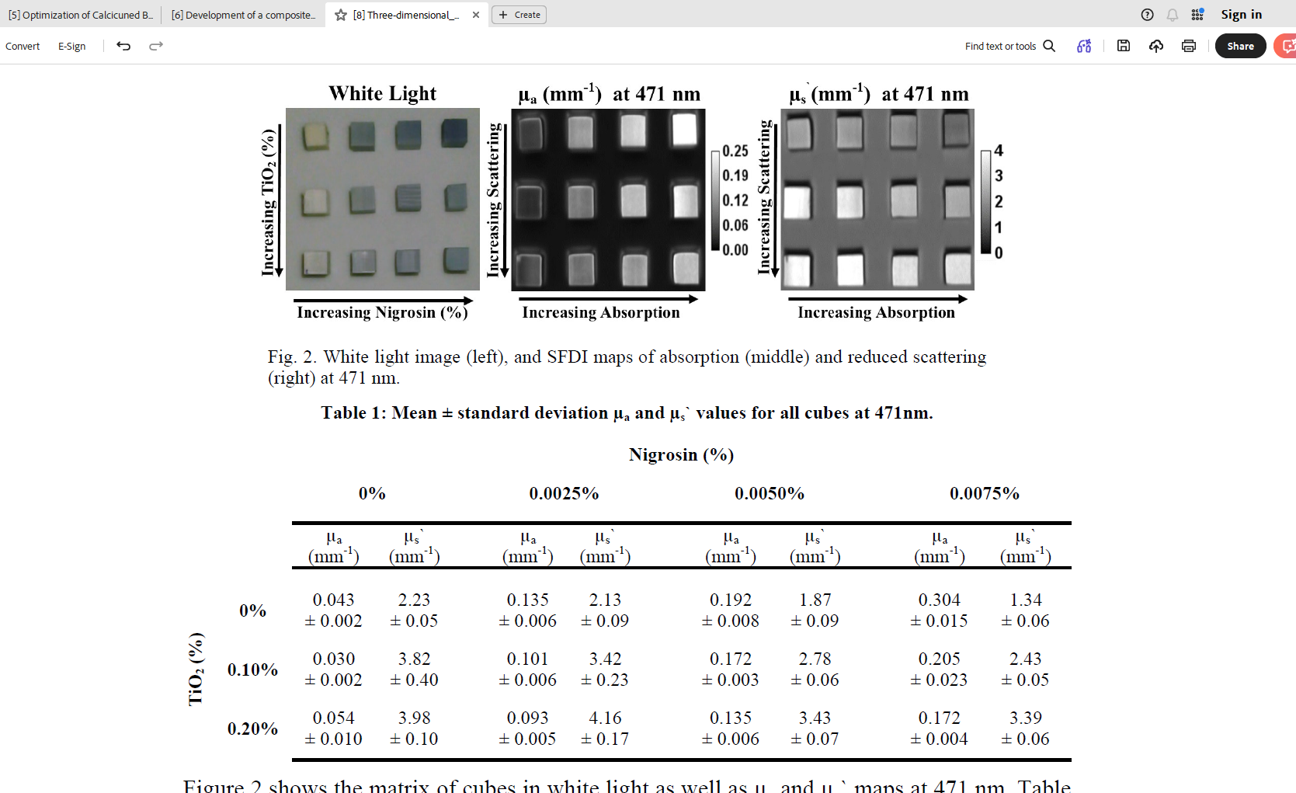
3D printed ABS Optical Bone Phantom
Three-dimensional printed optical phantoms with customized absorption and scattering properties
A key step to improving the versatility of 3D printed optical phantoms is the ability to alter the raw materials’ intrinsic optical properties to match that of a know target tissue.
The methodology to customized optical phantoms is the addition of absorbing dye, nigrosine, and scattering agent, titanium dioxide TiO₂ , prior to extrusion.
Fig. White light image (left), and SFDI maps of absorption (middle)
and reduced scattering (right) at 471 nm.
Table 1: Mean ± standard deviation µ_{a} and µ_{s}’ values for all cubs at 471 nm.

Slide 12
3D printed ABS Optical Bone Phantom
Development of a composite using calcined bone powder and silane cross-linked alginate as bone substitute material
Fig. Absorption, averaged overall TiO₂ concentrations, and reduced scattering, averaged overall nigrosine concentration
of all 3D printed cubes for 471,526,591,621,659,691,731
Absorption coefficient of human bone (µ_{a}) : 0.01 – 0.05 mm⁻¹
Scattering coefficient of human bone (µ_{a}) : 20 – 45 mm⁻¹
Reduced Scattering coefficient of human bone (µ_{a}) : 2.0 – 4.5 mm⁻¹

Slide 13
3D printed ABS Optical Bone Phantom
Development of a composite using calcined bone powder and silane cross-linked alginate as bone substitute material
Filament preparation
Co-extruding a mixture of commercially available natural color ABS pellets with custom absorption and scattering ABS “chips”. (combining ABS with either nigrosine and TiO₂)
Fabrication of TiO₂ chip consisted with dissolving the 20g of ABS in 50 ml of acetone for at least 12 hours. 0.2 g of TiO₂ was mixed with 1000 µl of water and sonicated for 10 minutes. After that add to the ABS solution. The mixture was then poured into a 21x21 cm pan to a layer thickness of 1.5 mm and vacuumed to remove air bubbles. The pan consisting of ABS/TiO₂ solution were left in the 40 kPa vacuum overnight to dry and solidify. Once it is solidified the thin sheet is cut into 2 x 2 mm dimension.

Slide 14
3D printed ABS Optical Bone Phantom
Development of a composite using calcined bone powder and silane cross-linked alginate as bone substitute material
Filament preparation
The nigrosine chips were also created using the same protocol described above by using the 0.02g of nigrosine and 800 µl of water.
Nigrosin and TiO₂ chips were mixed together prior to extrusion in the desired mass ratio and added to the hopper throughout the extrusion process to provide a more homogeneous filament product.
30 g batch of raw ABS pellets and chips yielded approximately two 2x2x2 cm 3D printed cubes.

Slide 15
Characterization of 3D printed PLA/PCL/TiO₂ Composites for Cancellous Bone
In this study, the ultimate tensile strength was modified by blending different ratio of PLA and PCL resulting in an optimum value of approximately 30 MPa when the ratio of PLA to PCL reached 3:1.
It is observed that the addition of 1% TiO₂ to the immiscible PLA/PCL composite increase in the tensile strength up to 37 MPa.
Upon examining the biocompatibility of PLA/PCL/TiO₂ composite, vigorous cell growth was observed.
The final composite has a comparable mechanical strength of the ideal cancellous bone structure.
Fig. 3D printed model of cancellous bone with PLA/PCL/TiO₂ composite

Slide 16
Characterization of 3D printed PLA/PCL/TiO₂ Composites for Cancellous Bone
PLA is cheaper option to make the bone graft as the process of grafting is expensive using metal is expensive, and it can reduce the problems related to metal’s higher strength (stress shielding) and toxicity.
As PLA and PCL are synthetic biodegradable thermoplastic polymer, it is compatible to use with human body and TiO₂ is an inorganic particle exhibiting suitable biocompatibility and it is well-known for non-toxic depending on size of the particle and condition of aggregation.
The Materials used in the study are as followed:
The Polylactic acid (PLA) was a commercial grade with density of 1.24 g/cc.
The Polycaprolactone (PLC) has a density of 1.15 g/cc.
TiO₂ has a density of 4.26 g/cc.

Slide 17
Characterization of 3D printed PLA/PCL/TiO₂ Composites for Cancellous Bone
Filament Preparation
To make the filament, a blend was prepared to make pellets with the desired composition.
The first blends made were a mixture of PLA/PCL with different composition (75/25, 50/50, 25/75 wt%).
The mixing process starts by first melting the corresponding amount of PLA due to its higher melting point. PCL is then added and when the blend is uniformly mixed, the filler is added and stirred until a homogeneous mixture is achieved.
The blend of the PLA/PCL 75/25 wt% showed the best characteristics and add the 1 wt% TiO₂ to the ratio.

Slide 18
The End
THANK YOU FOR LISTENING
Thu Ta Zaw
2415121095

